Slide 1
To Extract Delivery Timing & Quantity (By Plan Lot)
Autojit : Admin & User Operation Flow
Material Control 2
10 June 23

Slide 2
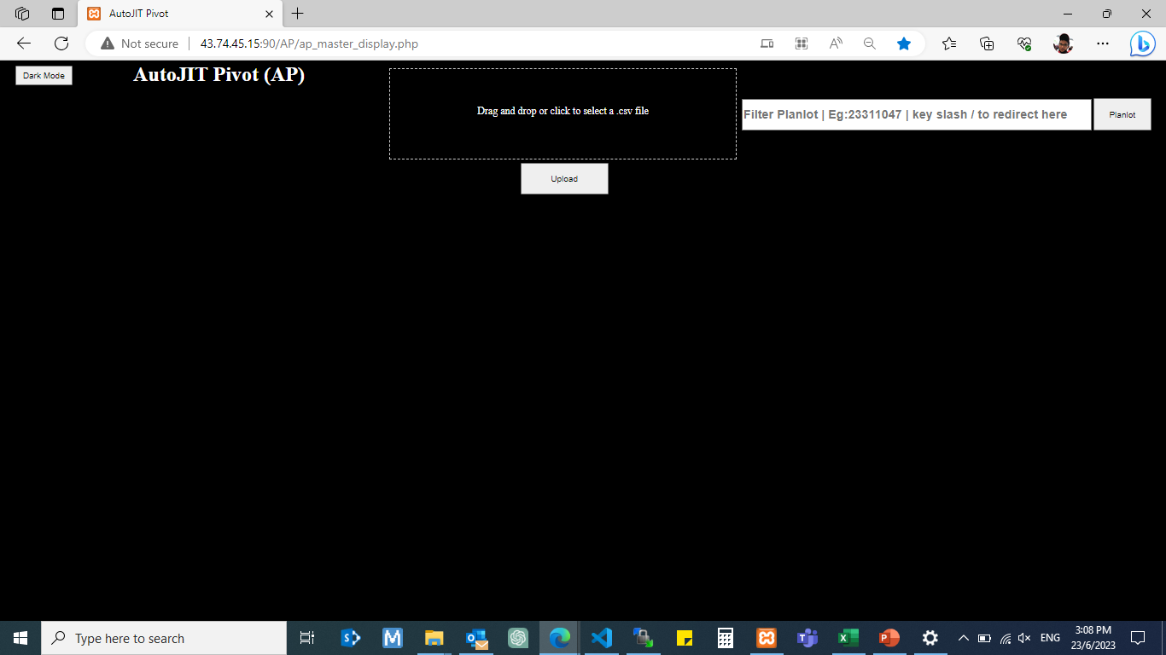
Admin
admin http://43.74.45.15:90/AP/ap_master_display.php

Slide 3
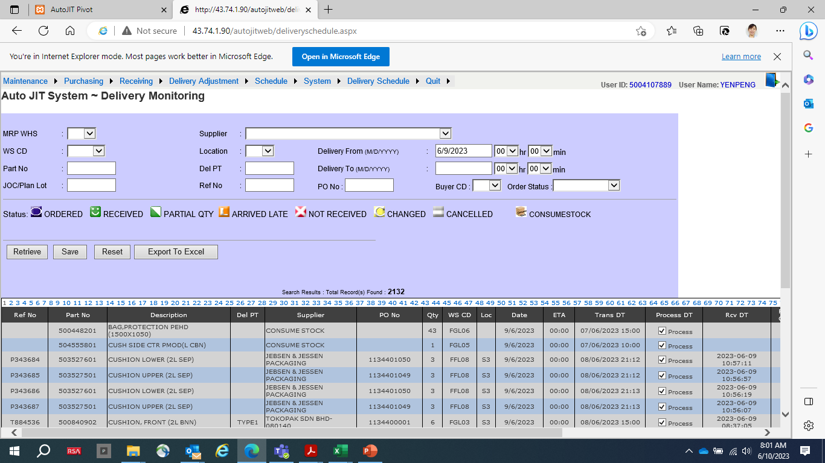
Admin : Extract AutoJit Delivery Schedule
http://43.74.1.90/autojitweb/deliveryschedule.aspx
Date: 9/6/23
Export to Excel

Slide 4
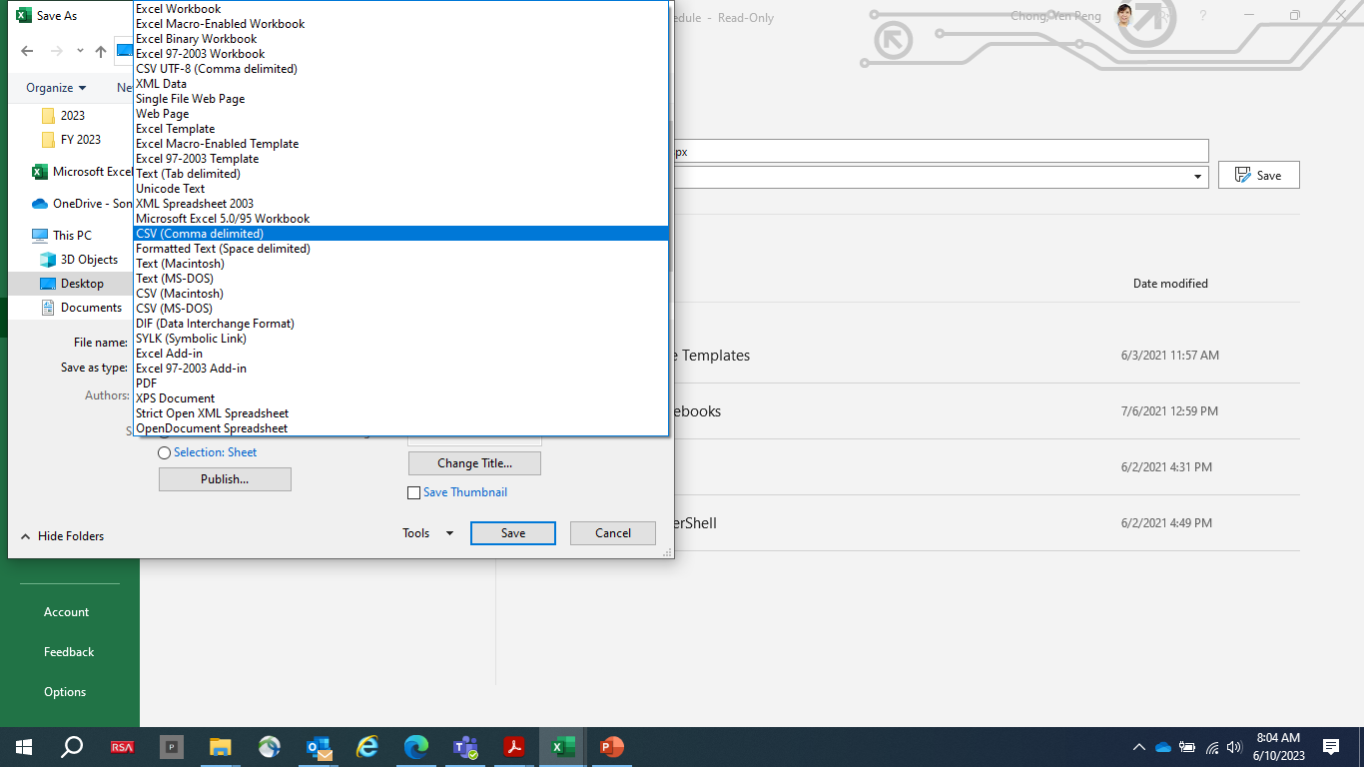
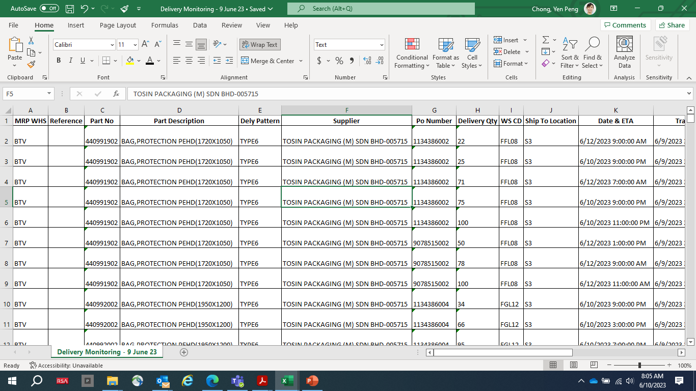
Admin : Make File : Delivery Monitoring - 9 June 23.csv
https://products.aspose.app/cells/conversion
Save File in CSV (Common Delimited) Format
Save in a folder

Slide 5
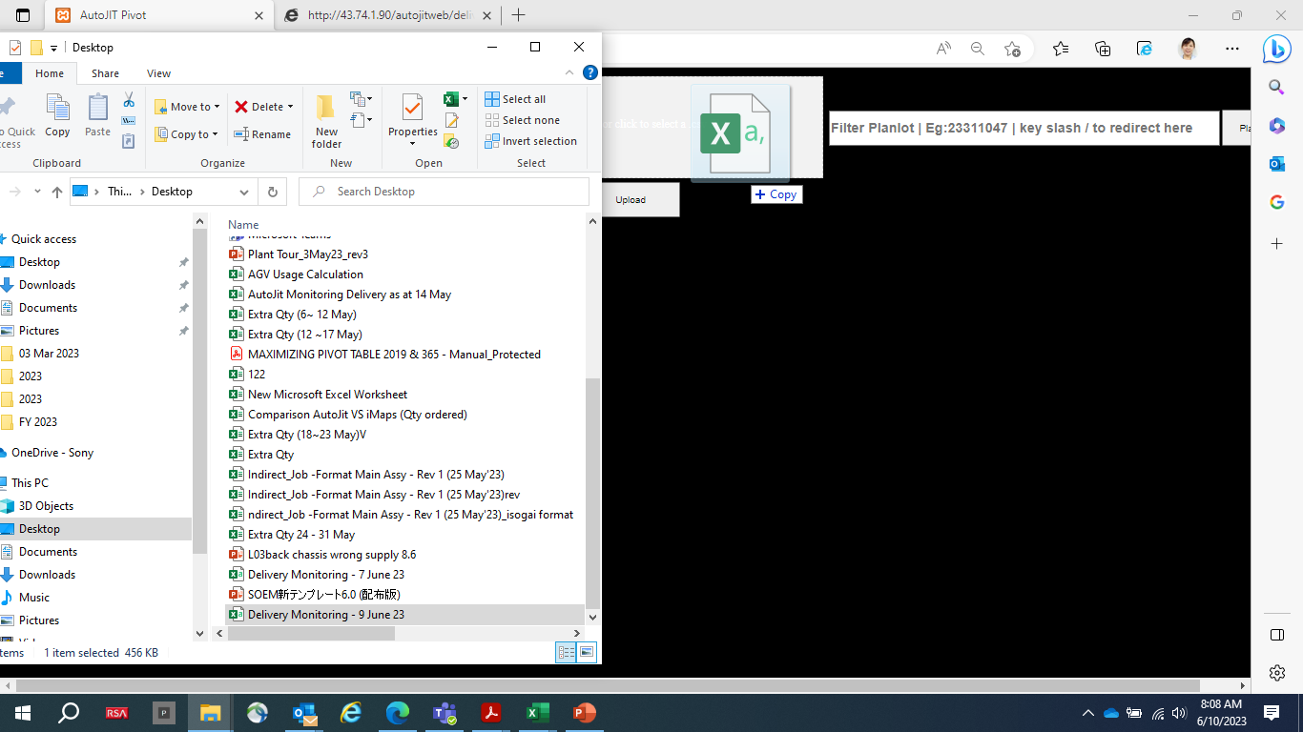
Admin : Making the Master File
Move the file to here

Slide 6
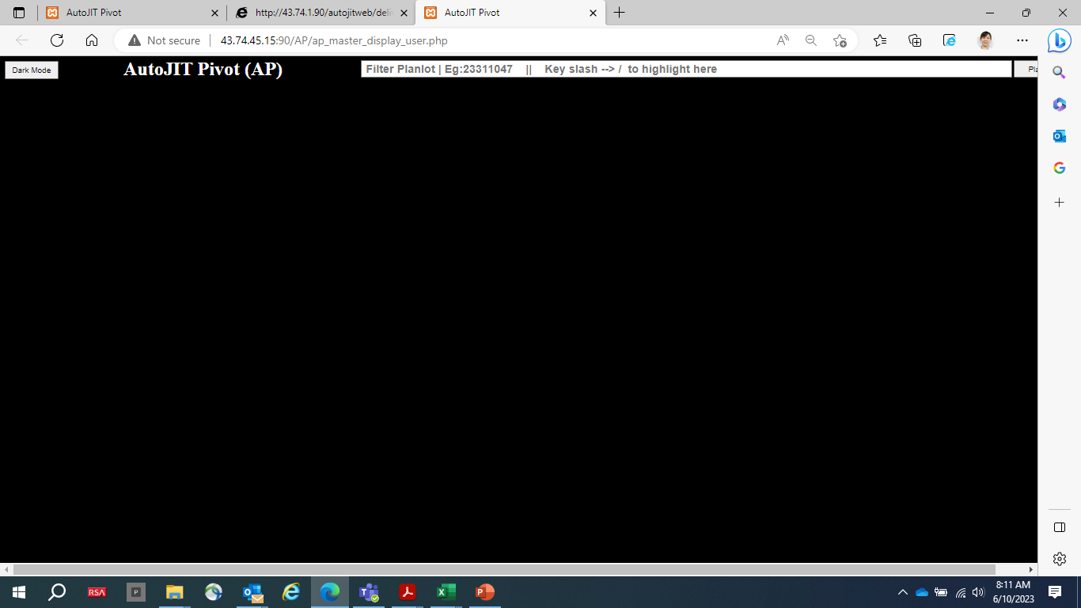
User
user
http://43.74.45.15:90/AP/ap_master_display_user.php

Slide 7
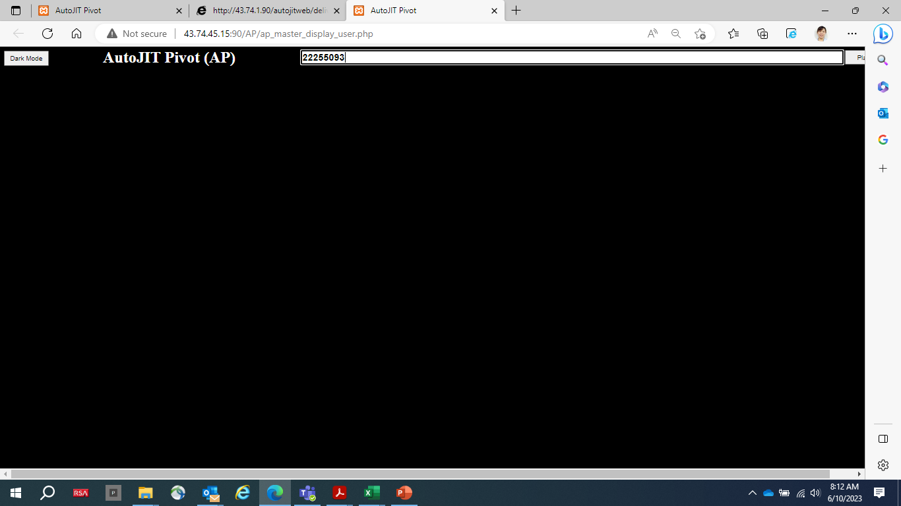
User : Select Plan Lot

Slide 8
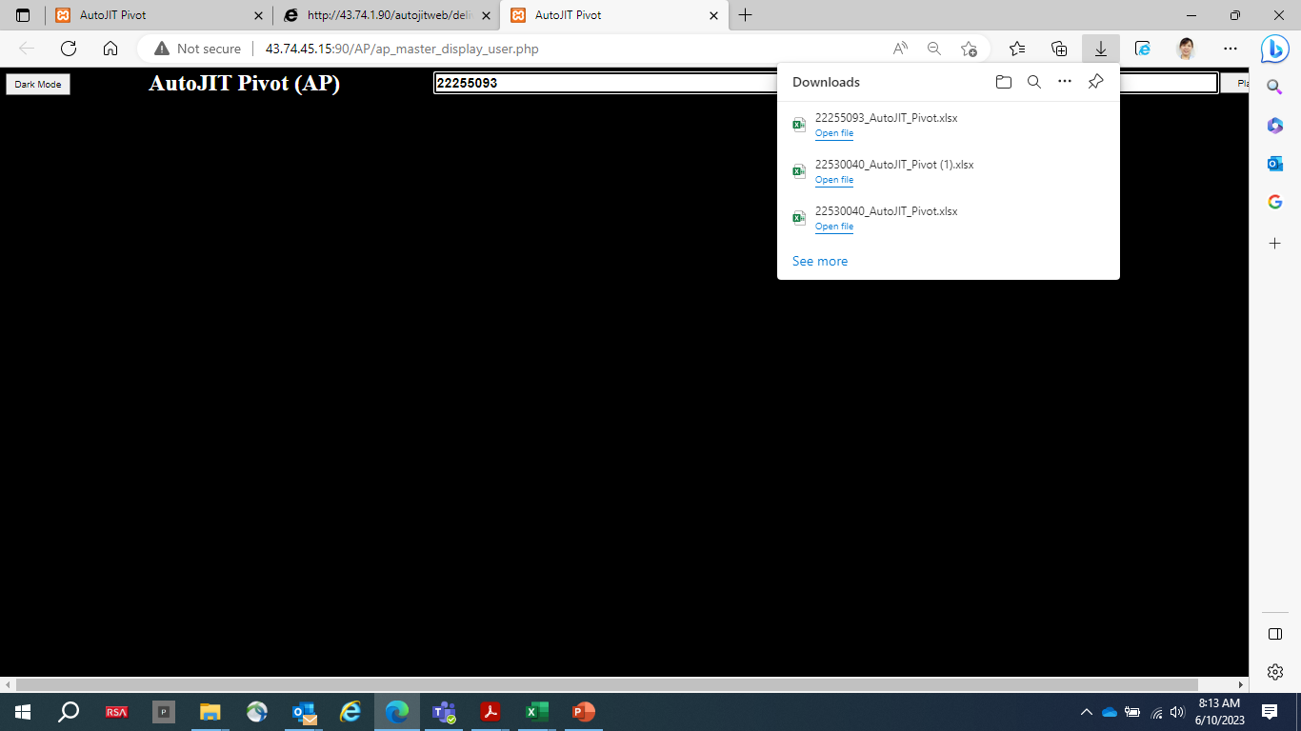
User : Download Excel File

Slide 9
User : Download Excel File

Slide 10
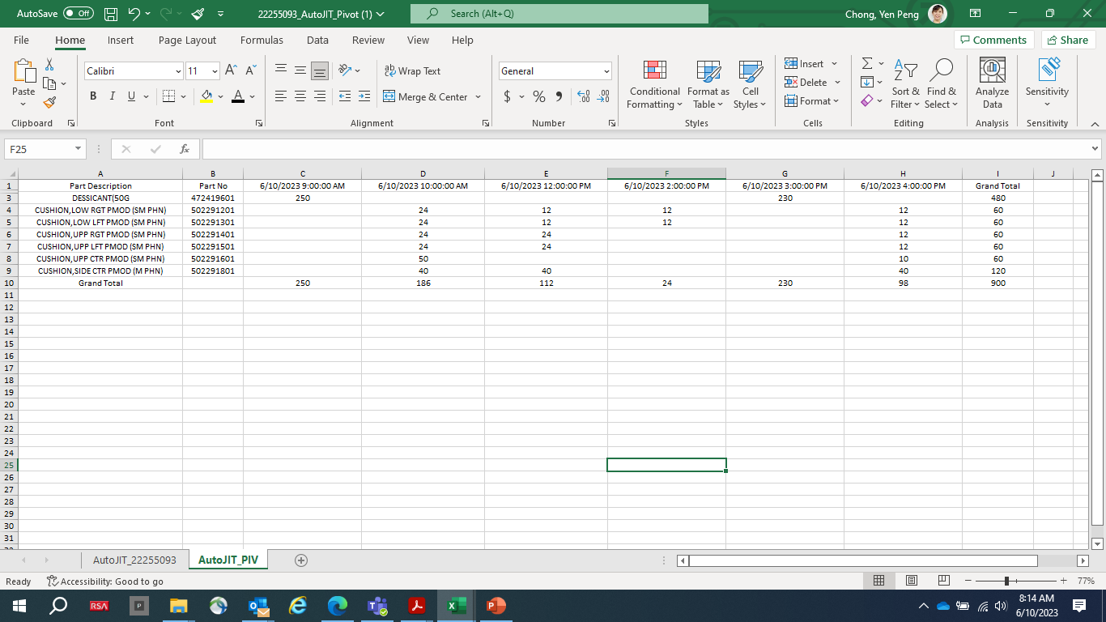
User : Open Excel to read the Delivery Timing & Ordering Qty

Slide 11
Thank You

Slide 12
To compare iMaps Vs AutoJit
Autojit : Admin & User Operation Flow
Material Control 2
10 June 23

Slide 13
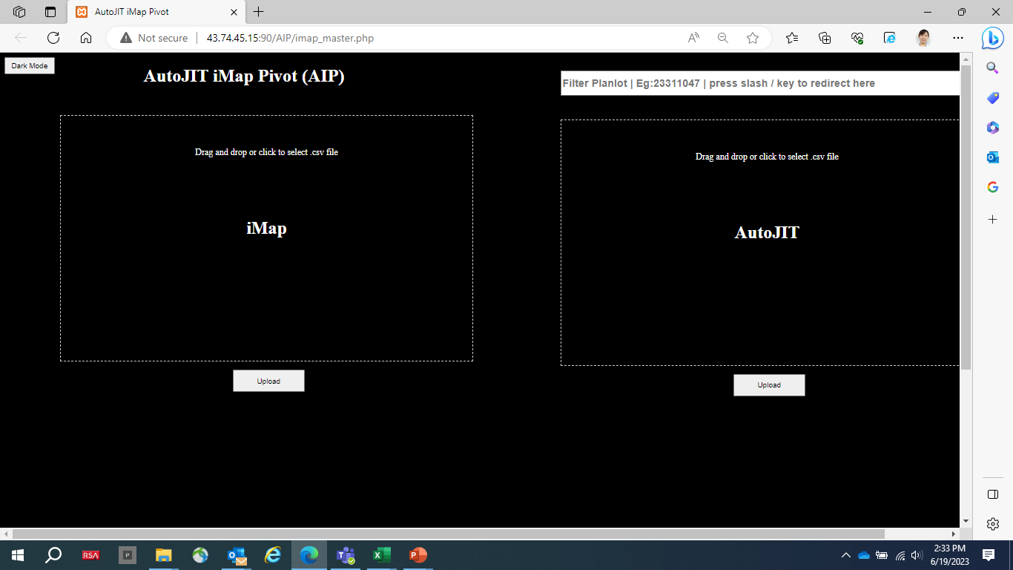
Admin
admin http://43.74.45.15:90/AIP/imap_master.php

Slide 14
Admin : Extract iMap
Do the same just like AutoJIT
Go to iMap extract page
Save as CSV
Drag and drop upload
Done.

Slide 15
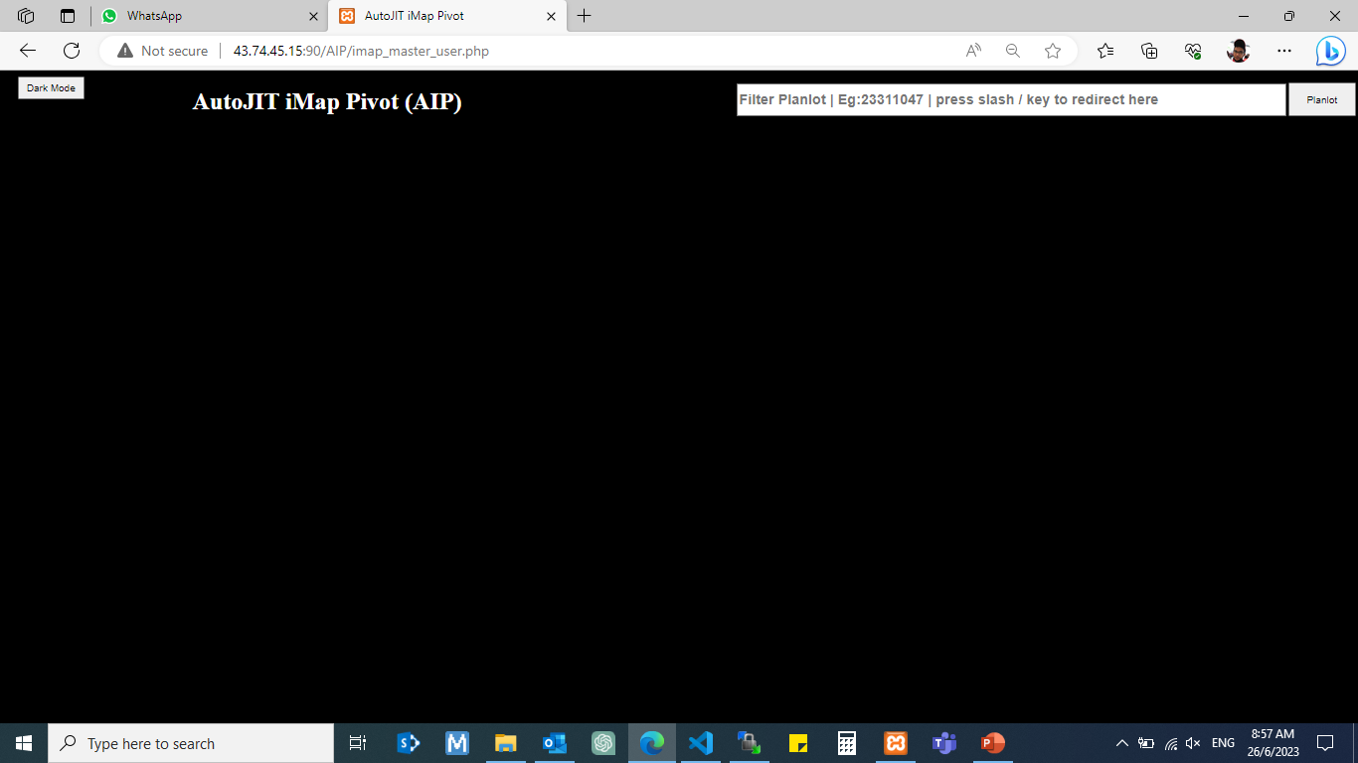
User
User
http://43.74.45.15:90/AIP/imap_master_user.php

Slide 16

User : Select Plan Lot

Slide 17
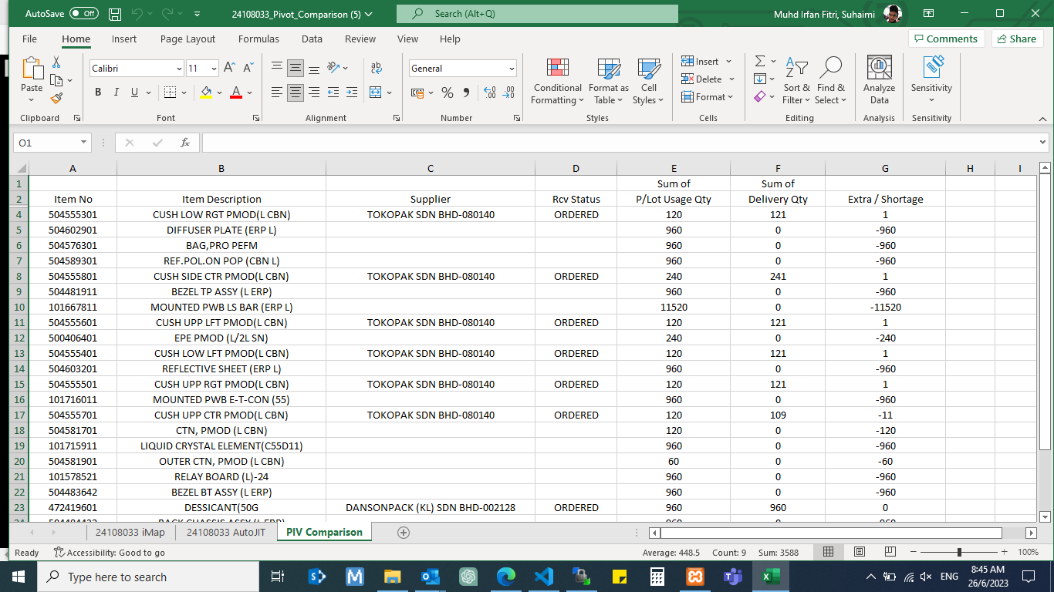
User : Open Excel to Compare iMaps Vs AutoJit

Slide 18
Thank You

